Slide 1
Using BERT and other NLP tools to identify economic relationships in economic texts

Slide 2
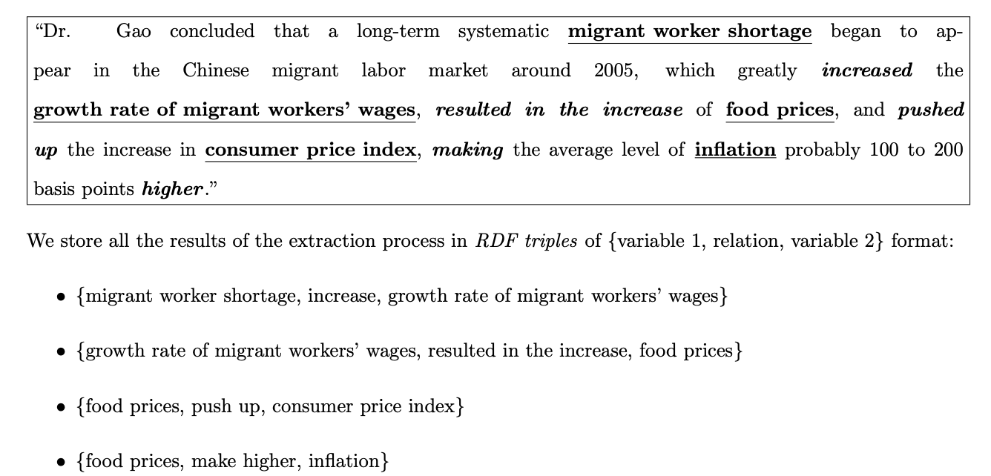
Problem Statement
Can we extract relationships from economic text
The Knowledge Graph for Macroeconomic Analysis with Alternative Big Data - Yucheng Yang and Yue Pang and Guanhua Huang and Weinan E - 2020
Notes:
@misc{yang2020knowledge,
title={The Knowledge Graph for Macroeconomic Analysis with Alternative Big Data},
author={Yucheng Yang and Yue Pang and Guanhua Huang and Weinan E},
year={2020},
eprint={2010.05172},
archivePrefix={arXiv},
primaryClass={econ.GN}
}

Slide 3
Underlying Motivation
Interested in how overlooked variables may influence economic trends, combining related fields, maximizing effect of past research

Slide 4
Approach
The paper used syntactic parse trees, keywords, and lots of human oversight
My Approach:
  Step 0: Mine data
    Text containing relationships – Federal Reserve Beige Book, San Francisco Fed Reports, open source textbooks, St. Louis Fed FRED database terms,
  Step 1: Identify economic variables
    Pretrain + finetune BERT on EV identification
    Use Spacy to take apart economic databases and identify words and phrases relavent
  Step 2: Extract the relationships between the variables

Slide 5
Problems
Appropriate economics text
Economic variables are not easy to identify unless you are willing to do a lot of manual review
  They are usually not proper nouns, are often common words, and have many modifiers
  Finding negative examples is not easy

Slide 6
Approach 1 - Using RoBERTa to identify variables
Used opensource textbooks and attached glossaries – free labels!
Pretrained RoBERTa and tokenizer on series of Federal Reserve documents dealing with economic variables. Finetuned using the textbooks and labels

Slide 7
Approach 2 – Extracting Terms from FRED Database
640,000 economic variables
Use Spacy to identify noun chunks
Run these through a genism phraser
Filter out single stopwords, proper nouns, anything phrases/words with a count less than 3
For all multiword phrases, find all words that are in more than 3 multiword phrases and add those to the list
Go through Federal Reserve Documents and tag any noun chunks that contain the single words or multiword phrases

Slide 8
Extracting Relationships
I used Bert for relationship extraction – available at https://github.com/plkmo/BERT-Relation-Extraction
Pretraining – reducing cosine similarity between relational relationships between two entities
Fine tuning on SemEval task 8 dataset

Slide 9
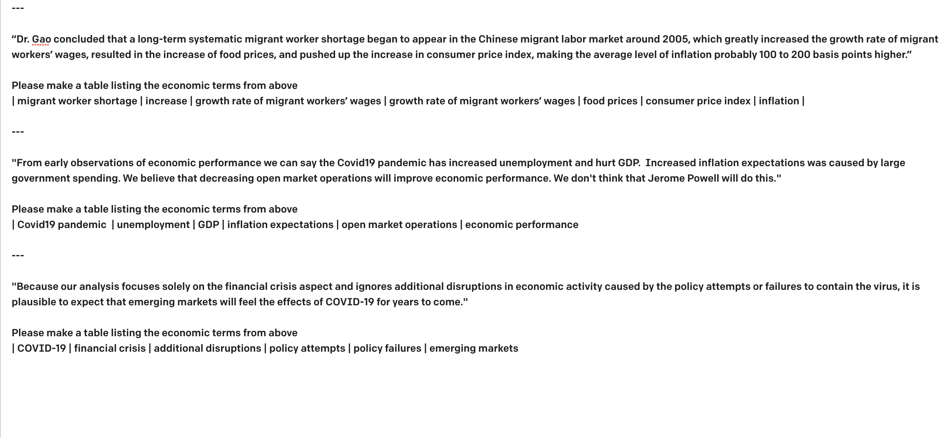
Ways to improve – throw it into GPT3?

